Slide 1
IntelliHealth: AI-Enhanced Health Monitoring Platform
SOEN 6841 - Software Project Management
Group 24
Rishi Ravikumar (40269971)
Md Abdul Hai (40270829)
Tania Sanjid (40255010)
Vedant Gadhavi (40269585)
Github Repository Link: https://github.com/Anik131/SOEN-6841-Software-Project-Management

Slide 2
Agenda
Introduction
Market Justification
Feasibility study
Solution Approach
Project Plan
Risk Management Plan
Budget Overview
Notes:
Speaker: Rishi Suggested points to talk: - Brief overview of the problem or opportunity and the proposed solution
15 seconds

Slide 3
Introduction
Notes:
Speaker: Vedant
Suggested points to talk:
⁠Hook or attention-grabbing introduction.
Audience questions
High level goals of our solution
30-45 seconds

Slide 4
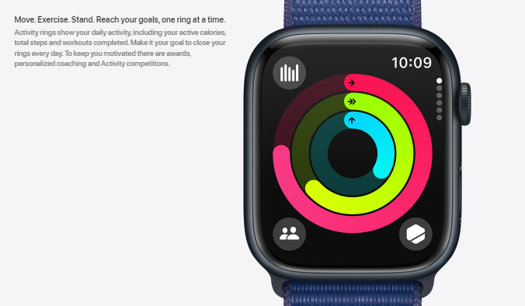
Market Justification
Apple Fitness Downsides:
Limited compatibility with non-Apple devices may alienate potential users.
Subscription-based pricing models may deter some users.
May lack advanced health insights compared to specialized health monitoring systems.
Source: https://www.apple.com/ca/apple-watch-series-9/why-apple-watch/
Notes:
Speaker: Tania
Suggested points to talk:
Refer to these points (https://docs.google.com/document/d/1t0nf5Yr9Ae4v4efgyAi6LcTGbkjgGz5JFfAA7cZ2G1o/edit#heading=h.dox9tvby1ceo)
1 minute

Slide 5
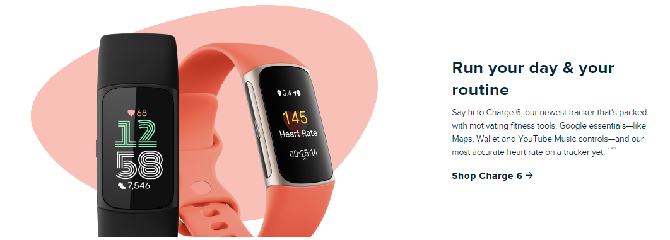
Market Justification
Fitbit
Downsides:
Limited health insights beyond basic metrics.
Some users report inaccuracies in tracking data affecting trust in the system.
https://www.fitbit.com/global/us/products/whats-new
Notes:
Speaker: Tania
Suggested points to talk:
Introduce the market analysis and justification process
Apple fitness market analysis
Refer to these points (https://docs.google.com/document/d/1t0nf5Yr9Ae4v4efgyAi6LcTGbkjgGz5JFfAA7cZ2G1o/edit#heading=h.dox9tvby1ceo)

Slide 6
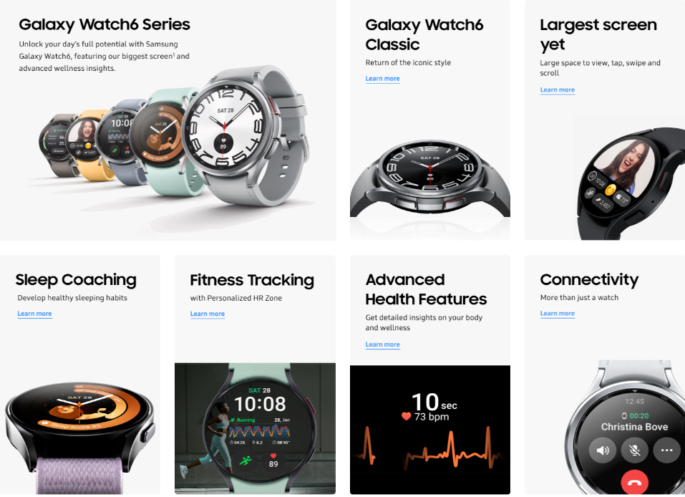
Market Justification
Samsung Health
Downsides:
Limited compatibility with non-Samsung devices may limit the user base.
Interface complexity may be overwhelming for some users.
https://www.samsung.com/us/watches/
Notes:
Speaker: Tania
Suggested points to talk:
Refer to these points (https://docs.google.com/document/d/1t0nf5Yr9Ae4v4efgyAi6LcTGbkjgGz5JFfAA7cZ2G1o/edit#heading=h.dox9tvby1ceo)

Slide 7
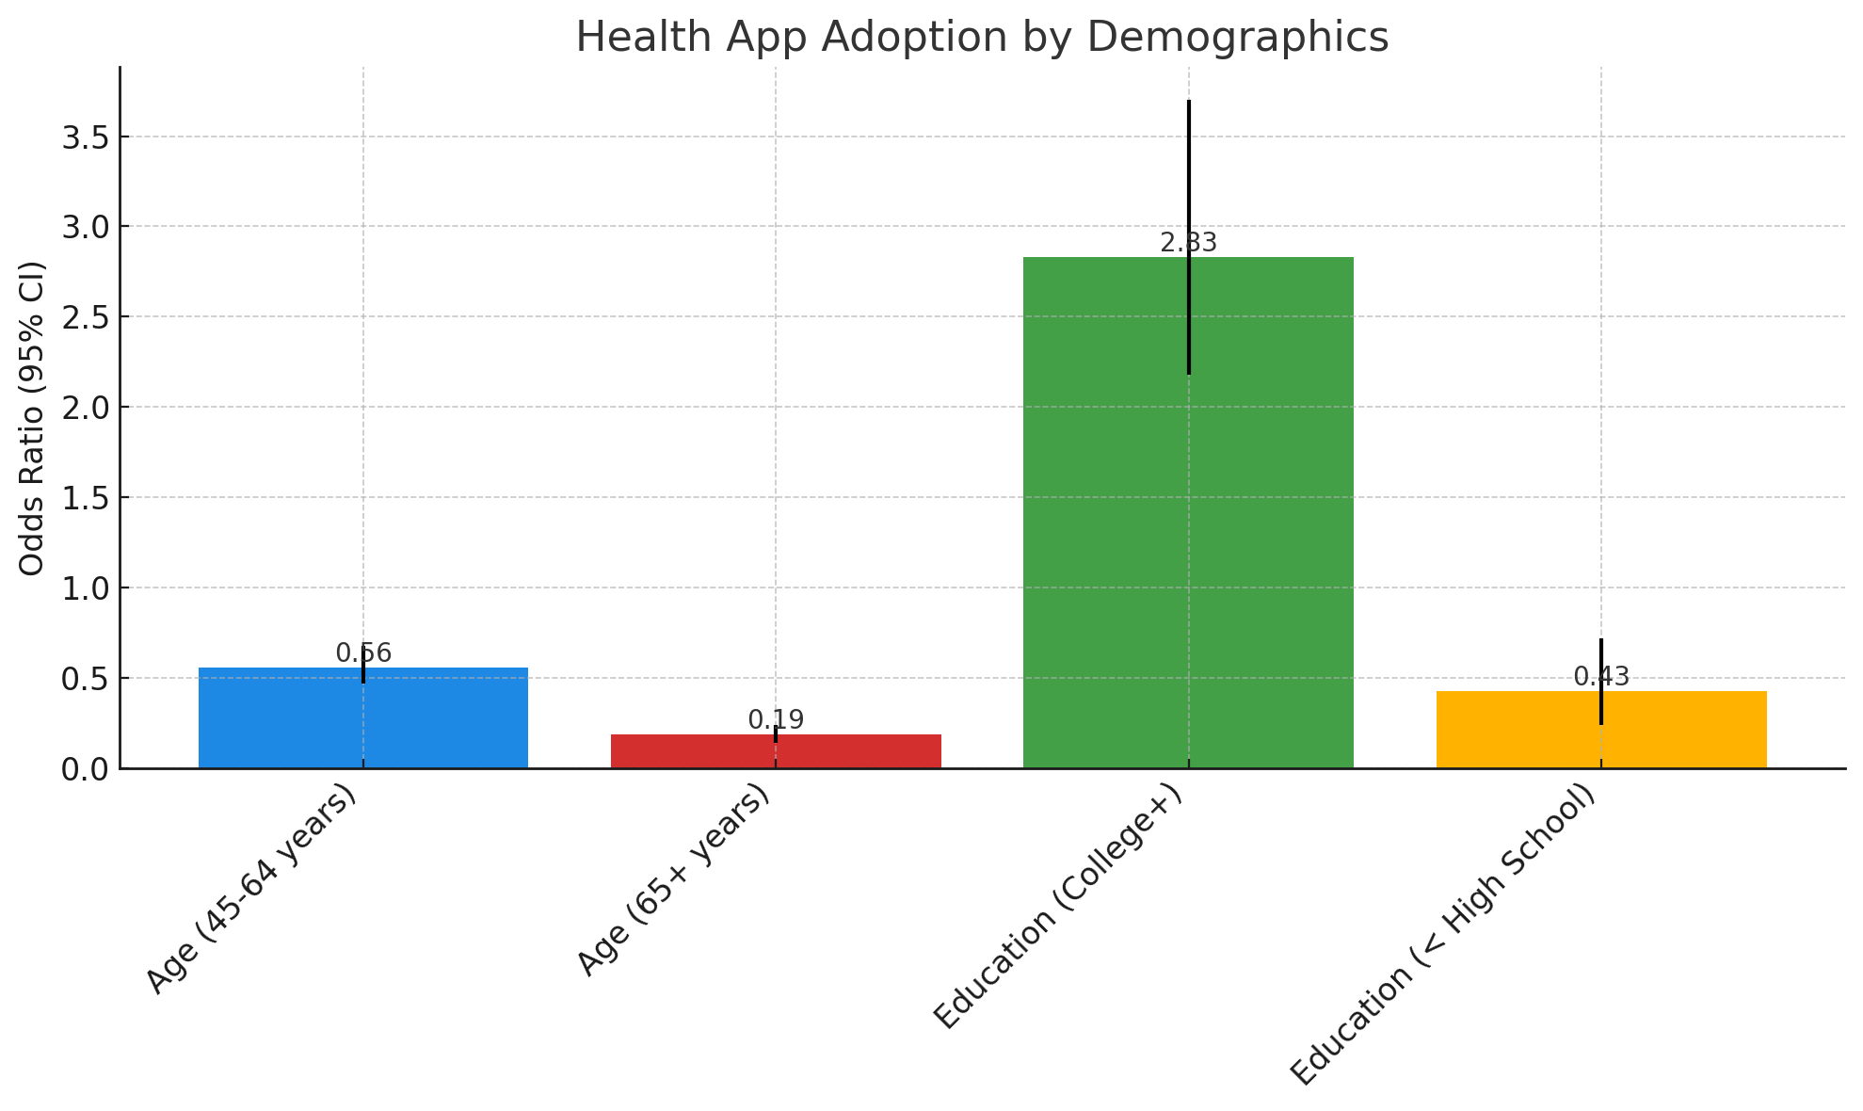
Market Justification
Mobile & Health App Usage Trends :
Mobile Usage: Steep increase to over 90% globally by 2020.
Health Apps: Over 100,000 available, indicating strong public interest in digital health management tools.
Survey Insights:
Conducted by the National Cancer Institute across various demographics.
Highlighted the widespread adoption of health apps, especially among younger, educated demographics.
Notes:
Speaker: Tania
Suggested points to talk:
Survey analysis
Refer to these points (https://docs.google.com/document/d/1t0nf5Yr9Ae4v4efgyAi6LcTGbkjgGz5JFfAA7cZ2G1o/edit#heading=h.dox9tvby1ceo)

Slide 8
⁠Feasibility and Viability
Technical Feasibility Assessment
Incorporating Advanced Technology, Tools and Infrastructure
Overcoming Technical Challenges
Operational Feasibility Examination
Alignment with the organization's vision
Incorporation into organizational workflows and procedures
Economic Feasibility Evaluation
Thorough examination of costs and benefits
Comprehensive estimation of project costs
Notes:
Speaker: Anik
1 minute

Slide 9
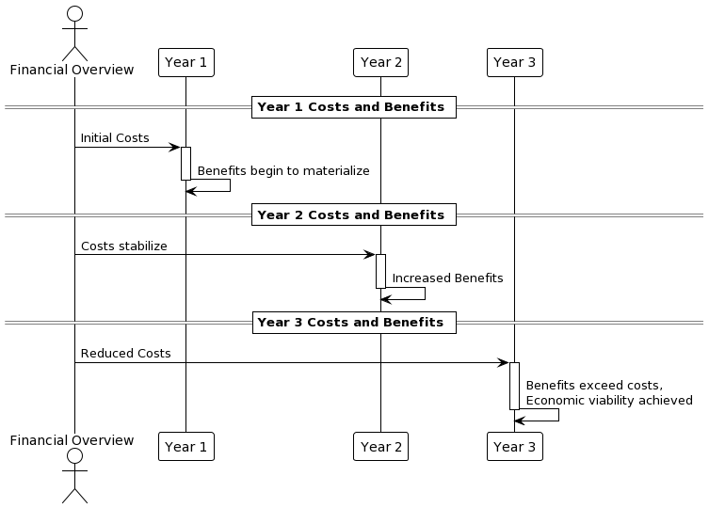
⁠Feasibility and Viability
⁠
Notes:
Speaker: Anik

Slide 10
Solution Approach
Key Features and Functionalities
Functional Requirements
Real-time data ingestion
Efficient data processing
Advanced data analytics
Alerting and Notifications
Monitoring
Configuration
Notes:
Speaker: Rishi
1 minute

Slide 11
Solution Approach
Key Features and Functionalities
Non-functional Requirements
Reliability
Scalability
Performance
Traceability
Security
Service Availability (3 nines)
Notes:
Speaker: Rishi

Slide 12
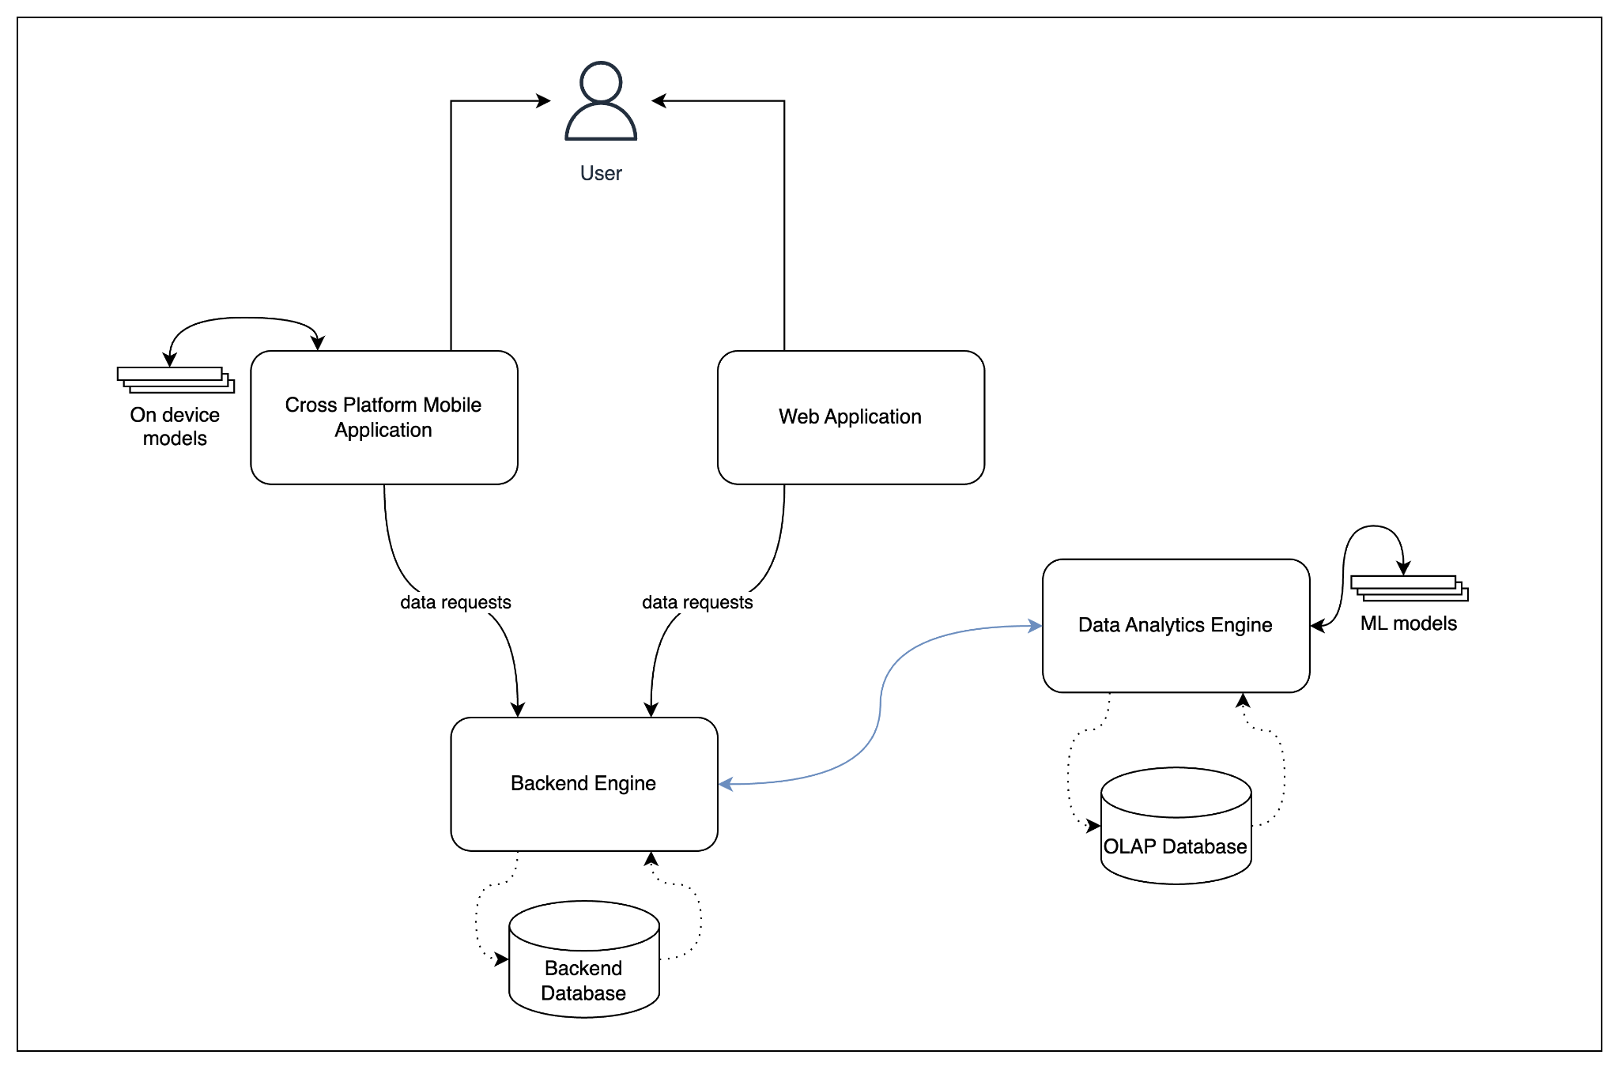
Solution Approach
Subsystems
Cross Platform Mobile Application
Web Application
Data Analytics Engine
Backend Engine
Notes:
Speaker: Rishi

Slide 13
Project Plan
Summary of the project plan
Agile Scrum
Collaboration Tools
Resource Plan
Core Development Team
Technical Resources
Infrastructure Requirements
Notes:
Speaker: Rishi
30 seconds

Slide 14
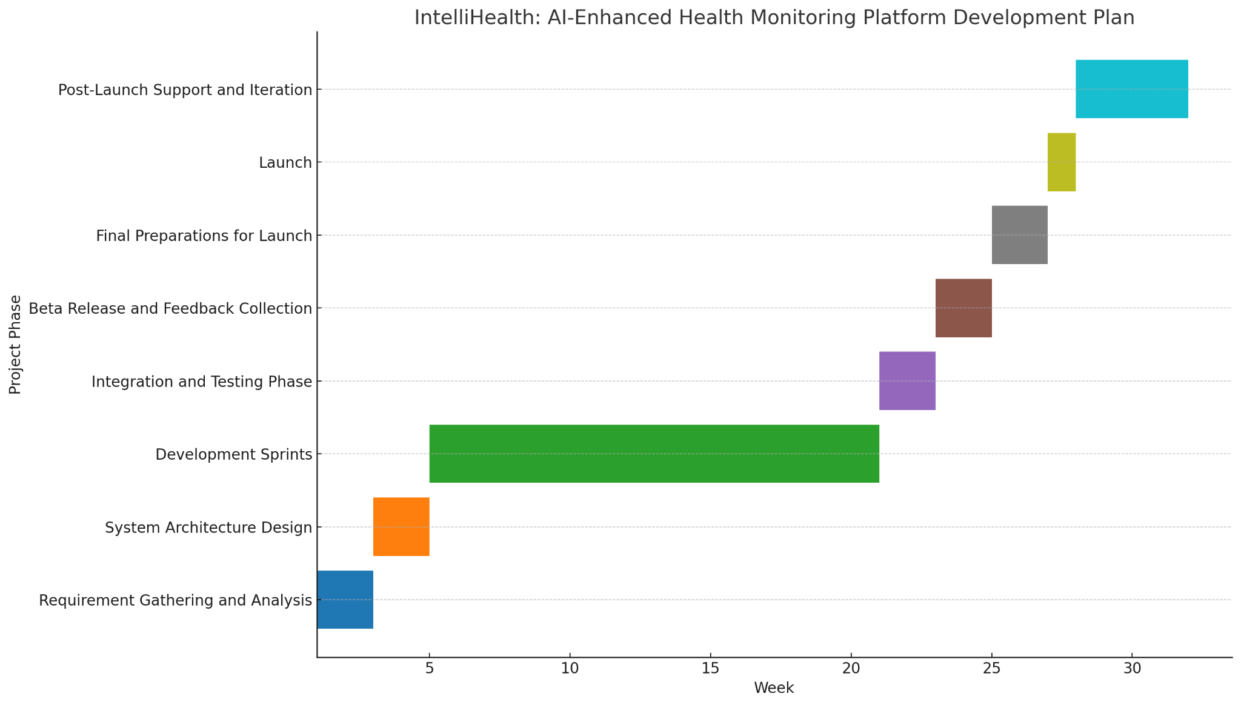
Project Plan
Milestones and Deliverables Detailed Breakdown
Notes:
Speaker: Rishi

Slide 15
Risk Management Plan
Risk Identification
Technical Risks
Integration challenges with wearable devices
Complexity in developing AI algorithms
Data accuracy concerns
Operational Risks
Inadequate user adoption
Technical glitches
Insufficient training data for AI models
Economic Risks
Budget constraints
Market fluctuations
Increased competition
Notes:
Speaker: Vedant
30 seconds

Slide 16
Risk Management Plan
Impact Analysis
Integration challenges with wearable devices
Impact: User frustration and decreased engagement
Likelihood: Moderate
Severity: High
Data accuracy concerns
Impact: Loss of credibility and improper health insights
Likelihood: Low
Severity: High
Insufficient training data for AI models
Impact: Reduced accuracy of predictions
Likelihood: Moderate
Severity: High
Notes:
Speaker: Vedant

Slide 17
Risk Management Plan
Risk Mitigation Strategies
Integration challenges with wearable devices
To address integration issues promptly, conduct thorough compatibility testing and establish clear communication channels with manufacturers.
Data accuracy concerns
To ensure integrity, implement rigorous data validation procedures and invest in data quality assurance tools.
Notes:
Speaker: Vedant

Slide 18
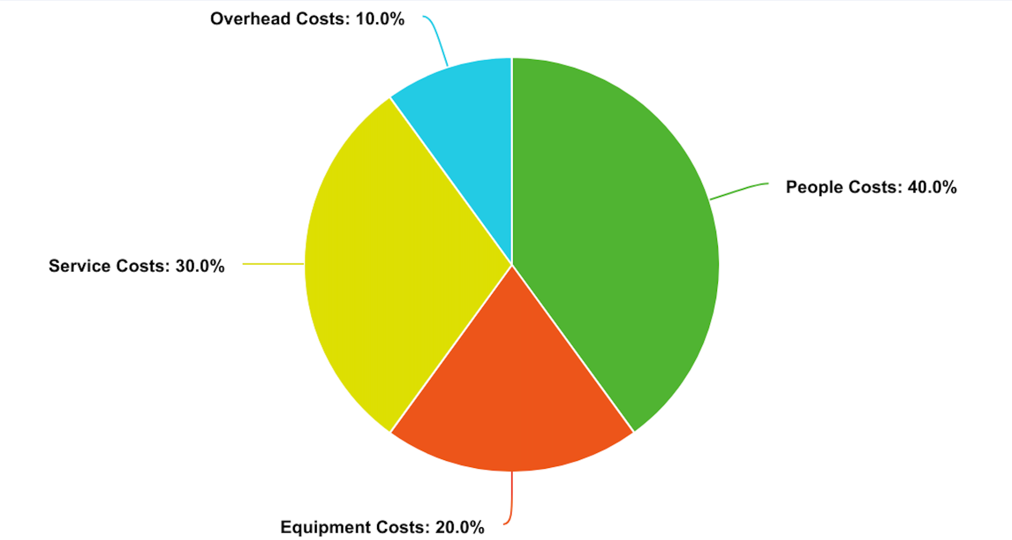
Budget Overview
Notes:
Speaker: Vedant

Slide 19
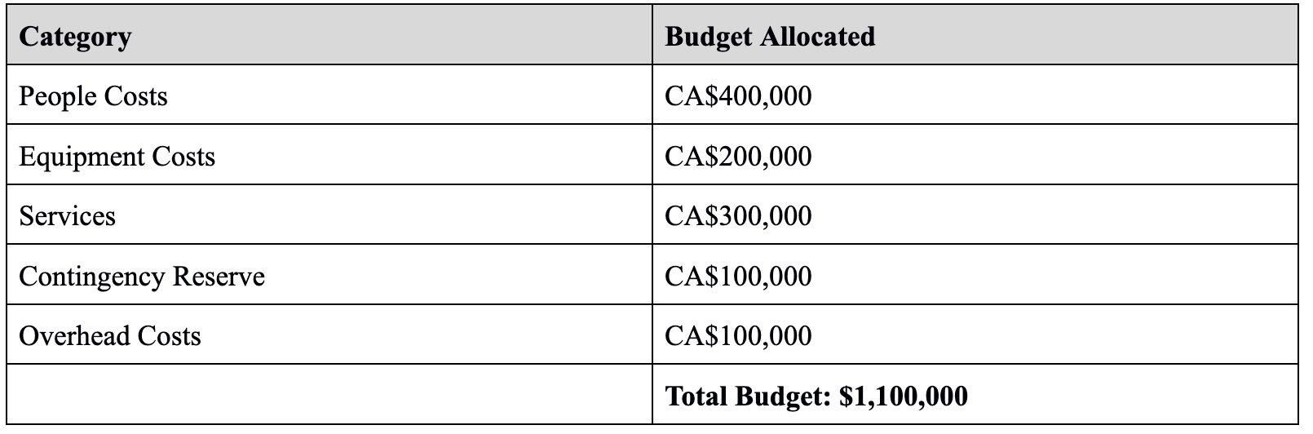
Budget Overview
Detailed breakdown
Notes:
Speaker: Vedant

Slide 20
Conclusion
Summary of Key Points
Market Justification
Feasibility study
Solution Approach
Project Plan
Risk Management Plan
Budget Plan
Notes:
Speaker: Rishi
30 seconds

Slide 21
Questions
?
Notes:
Speaker: Rishi
30 seconds

